Slide 1
Chapter 1
Introduction to Computers and Programming

Slide 2
Computer Components
Computer : programmable machine designed to follow instructions. It is composed essentially by two parts:
  Hardware : equipment used to perform computations
  Software: programs used to execute on a machine by providing the list of instructions to follow.

Slide 3
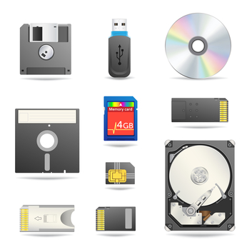
Computer Hardware
Secondary Storage
Input Devices
Output Devices

Slide 4
Computer Hardware: Main Memory
  Stores instructions and data that are to be processed by the computer.
  RAM - Random Access Memory - Memory that can be accessed in any order (as opposed to sequential access memory), volatile. Main memory is erased when program terminates or computer is turned off
  ROM - Read Only Memory - store program or data permanently, used to store startup and critical instructions. no-volatile.

Slide 5
Computer Hardware: Secondary Memory
Mass storage device.
Stores instructions and data between sessions. Non-volatile: data retained when a program is not running or a computer is turned off
Comes in a variety of media:
– magnetic: floppy disk, zip disk, hard drive
– optical: CD-ROM
– Flash drives, connected to the USB port
– Hard disk

Slide 6
Computer Hardware: CPU
Coordinating all computer operations and performing arithmetic and logical operations on data
Fetch instructions and perform the actual manipulation
Modern CPU is housed in a single integrated chip. (it also hosts registers, caches, etc.)

Slide 7
Computer Software
Operating System - controls the interaction between machine and user. Example: Windows, Unix, Dos etc.
  Communicate with computer and user.
  Manage memory.
  Collect input/Display output.
  Read/Write data.
Application Software - developed to assist a computer use in accomplishing specific tasks. Example: Word, Excel, Internet Explorer.
➔ Computers are worthless without Software/programs

Slide 8
Why programming ?
Without programming language we can never interact with computer or other electronic device.
All the device in present world runs on some code which is written with the help of some programming language
Knowing how to program is important to every student if they want a greater chance of succeeding in the future.
Students are falling behind in technological knowledge, and potential careers are blocked by lack of computer education at a young age. You will never know if you like something if you never get to try it.

Slide 9
Why programming ?
A program is a set of instructions that the computer follows to perform a task
Without programs, a computer/machine cannot do anything
We need to develop programs; using programming language; to make the computer/machine useful.
Programming Language: a language used to write programs

Slide 10
Types of Programming Language
High-level language : closer to human language
  A language that people can read, write, and understand
  Easy to write, easy to understand
  Can not be executed directly
  Complier is used to convert high-level language into the target computer’s machine language
  Example: C, C++, Java, Python, etc.
  Low-level: Assembly Language
  mnemonic codes that corresponds to machine language instructions.
  Very close to the actual machine language
  Machine language: A collection of binary numbers
    Often written in binary machine code (1/0)
    It is the only language that the computer can understand.

Slide 11
Problem Solving in Everyday Life
Identify the problem.
Understand the problem.
Identify alternative ways to solve problem.
Select best alternative.
List solution steps for alternative chosen.
Evaluate solution.

Slide 12
Types of Problems
Problems with …
Algorithmic solutions
  series of actions
Heuristic solutions
  require reasoning built on knowledge and experience, and a process of trial and error.
Combination of algorithmic and heuristic solutions

Slide 13
Problem Solving with Computers
Definitions:
Solution ⇔ instructions followed to produce best result
Result ⇔ outcome, computer-assisted answer
Program ⇔ instructions for solution using computer language

Slide 14
I can’t explain how I know, I just know it!
Which number is the largest?
  30
  60
  40

Slide 15
Difficulties with Problem Solving
Lack of problem solving experience
Inadequate solution steps
Incorrect problem definition
Alternatives chosen incorrectly
Invalid logic
Incorrect solution evaluation

